Slide 1
UNDERSTAND AZURE SUBSCRIPTIONS

Slide 2
Agenda
Azure subscription
Users and options with Azure Subscriptions

Slide 3
Azure subscriptions
You get an Azure subscription automatically when you sign up for Azure and all of the resources you create are created inside that subscription. You can, however, create additional subscriptions that are tied to your Azure account.
you can manage your subscription in the Azure portal. You can view and manage costs, you can give other people access to it using RBAC, you can apply locks to it, and so on.
Quotas:
You can have up to 200 Azure Storage accounts per region in a subscription, up to 25,000 virtual machines per region, and up to 980 resource groups per subscription across all regions.
Notes:
You can find details on all limits for subscriptions at: https://docs.microsoft.com/azure/azure-subscription-service-limits.

Slide 4
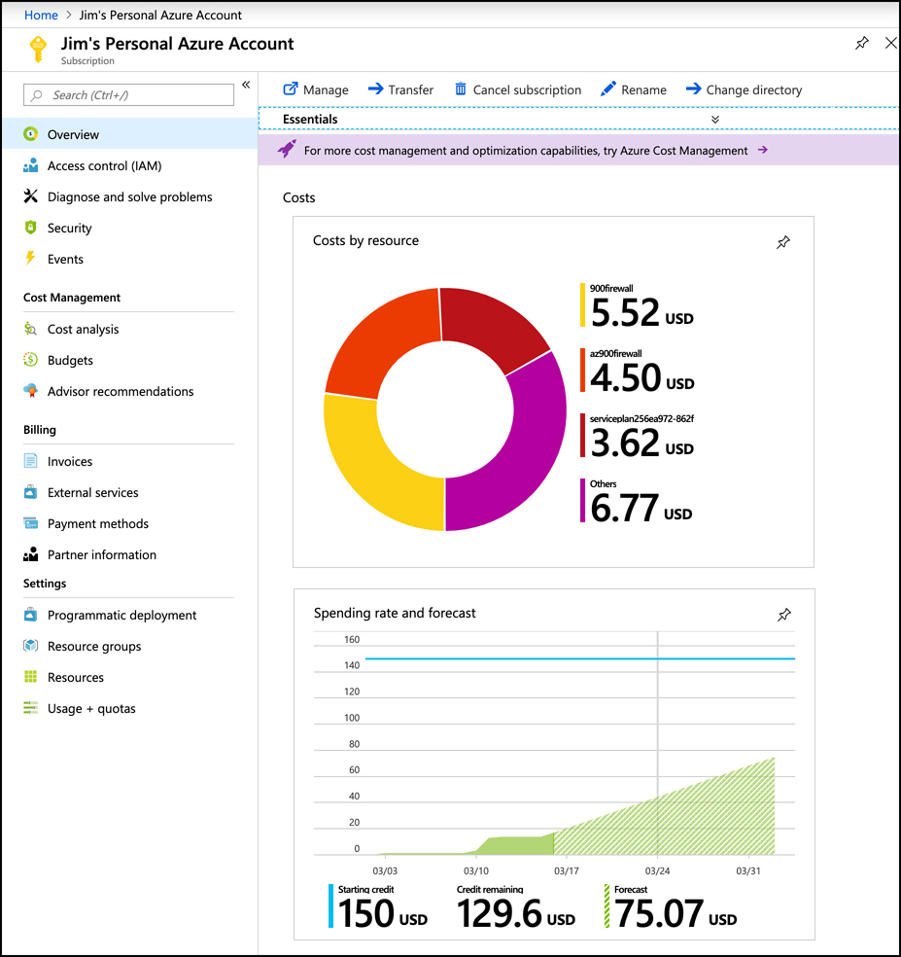
Azure subscriptions
On the Overview blade, you can see a cost breakdown for each of the resources. You can also see the spending rate for the subscription, along with a forecasted cost by the end of the current month.
You can see all of the past invoices by clicking on Invoices in the menu for the subscription
Notes:
You can find details on all limits for subscriptions at: https://docs.microsoft.com/azure/azure-subscription-service-limits.

Slide 5
Agenda
Azure subscription
Users and options with Azure Subscriptions

Slide 6
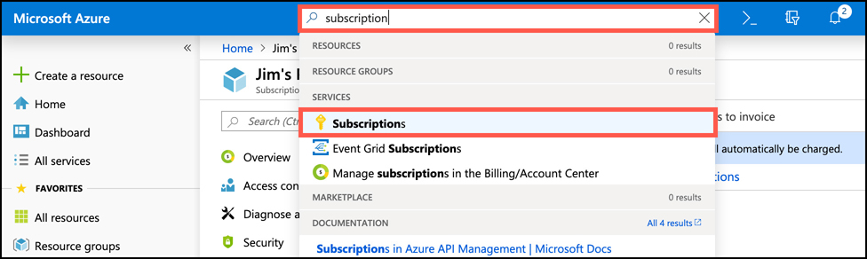
Users and Options
You can create additional Azure subscriptions in your Azure account. This is useful in cases where you want to separate costs or if you are approaching a subscription limit on a resource.
To create a new Azure subscription, enter subscription in the search box and click on Subscriptions.
To create a new subscription, click on Add in the Subscriptions blade

Slide 7
Users and Options
You need to choose which type of subscription you want to create.
Free Trial Provides free access to Azure resources for a limited time. Only one free trial subscription is available per account, and you cannot create a new free trial if a previous one has expired.
Pay-As-You-Go You pay only for those resources you use in Azure. There’s no up-front cost, and you can cancel the subscription at any time.
Pay-As-You-Go Dev/Test A special subscription for subscribers to Visual Studio that can be used for development and test. This subscription offers discounted rates on VMs, but you cannot use this for production applications.
Each subscription is associated with a unique identifier called a subscription ID. You can give each subscription a descriptive name to help you identify it, but Azure will always use the subscription ID to identify your subscription. When you talk to Microsoft about your Azure account, they’ll also often ask for your subscription ID.

